Slide 1
XDTools: Testing and Debugging Cross-Device Applications
Master Thesis
Nina Heyder

Slide 2

Motivation
Motivation Related Work XDTools Architecture Sample Applications Evaluation Conclusion Future Work
Studies have shown that users already use multiple devices in parallel, but better functional coordination is needed
How can this be achieved?
Cross-device applications!
But how to test and debug them?
Cross-device frameworks?
Tools for testing web applications?
Frameworks provide little support
Testing multiple devices simultaneously is difficult with existing tools
Notes:
- You probably all have access to multiple devices and use them together
Normal people do that as well, not only computer scientist
Testing cross-device applications difficult
More advanced testing tools for XD testing could help spread XD apps

Slide 3
Related Work
Motivation Related Work XDTools Architecture Sample Applications Evaluation Conclusion Future Work
Web application testing and debugging
Browser-integrated debugging tools
Responsive web application testing
Web services
Record and replay
Automated testing tools
Testing with actual devices
Device emulation
Cross-device frameworks
Frameworks with tool support
Web-based frameworks
Web application testing and debugging
Browser-integrated debugging tools
Responsive web application testing
Web services
Record and replay
Automated testing tools
Testing with actual devices
Device emulation
Cross-device frameworks
Frameworks with tool support
Web-based frameworks
Web application testing and debugging
Browser-integrated debugging tools
Responsive web application testing
Web services
Record and replay
Automated testing tools
Testing with actual devices
Device emulation
Cross-device frameworks
Frameworks with tool support
Web-based frameworks
Examples
Chrome DevTools
Timelapse
Selenium
BrowserStack
BrowserSync
Chrome Device Mode
XDStudio
XD-MVC
Notes:
3 different categories of research

Slide 4
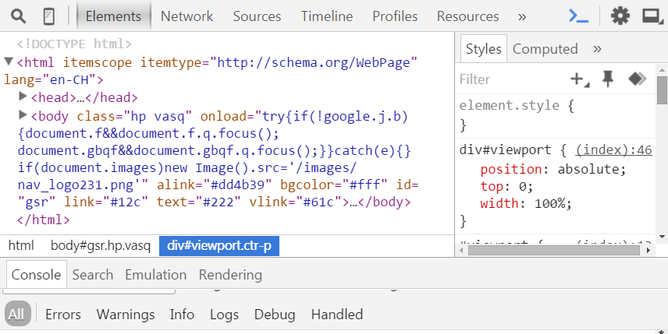
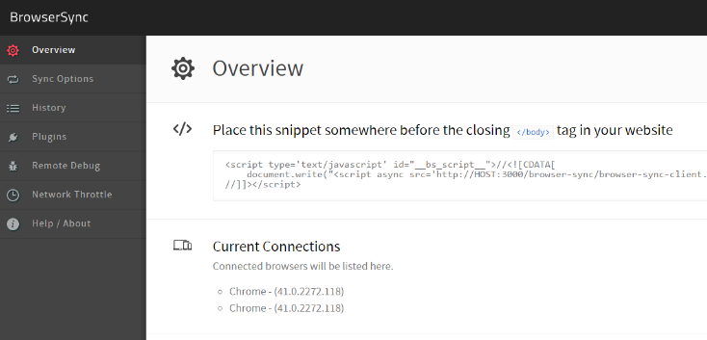
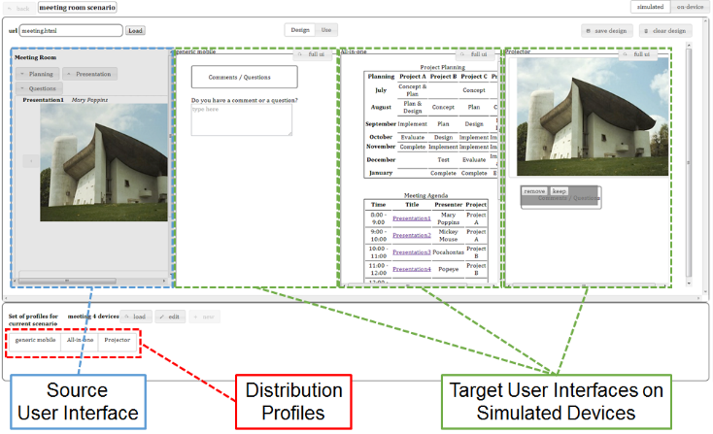
Examples
Motivation Related Work XDTools Architecture Sample Applications Evaluation Conclusion Future Work
Chrome DevTools
BrowserSync
XDStudio
DOM tree + CSS inspection and modification
JavaScript debugging
Console
Synchronize interactions
Remote debugging
Automatic refresh when files are changed
Simulated and on-device authoring
Use mode and design mode
Distribution profiles
Notes:
- Example from each of the 3 categories

Slide 5
XDTools
Motivation Related Work XDTools Architecture Sample Applications Evaluation Conclusion Future Work
EMULATION OF MULTIPLE DEVICES
SWITCHING OF DEVICE CONFIGURATIONS
INTEGRATION OF REAL DEVICES
INTEGRATION WITH DEBUGGING TOOLS
AUTOMATIC CONNECTION MANAGEMENT
RECORD AND REPLAY
Set of tools that facilitate the testing and debugging of cross-device applications
Notes:
XDTools

Slide 6
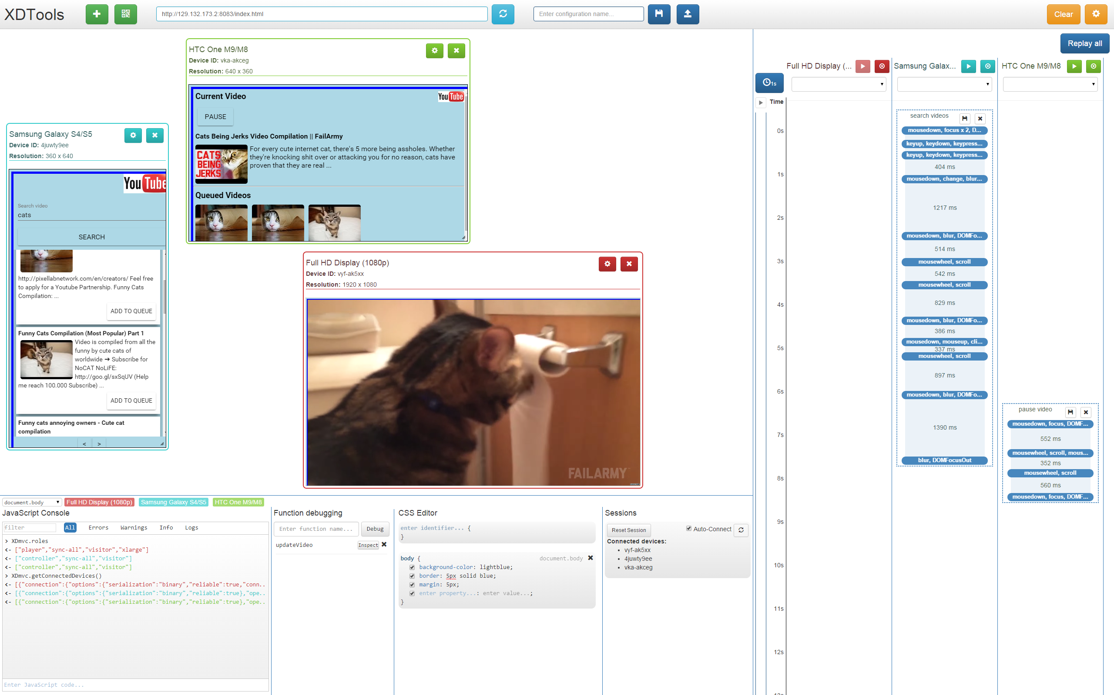
Adding devices
Loading URLs/Refreshing
Switching configurations
Record and replay
Emulated devices
Shared JavaScript console
Function debugging
Shared CSS editor
Connection management
Notes:
- Overview of the features of XDTools
- More detailed description later

Slide 7
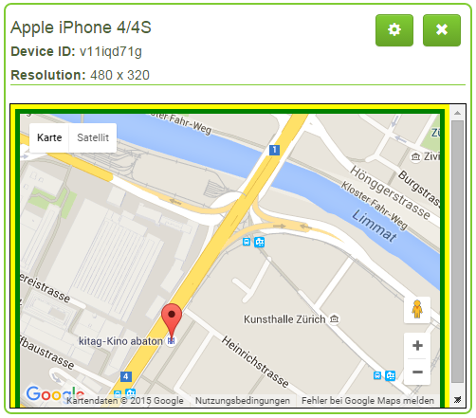
Emulation of Multiple Devices
Motivation Related Work XDTools Architecture Sample Applications Evaluation Conclusion Future Work
Goal: Emulate multiple devices in one browser window and prevent the sharing of local resources
Predefined and custom devices
Each device has a unique ID and color for identification
Devices can be
Moved
Scaled
Resized
Rotated
Emulated device
Notes:
- Show video!!!

Slide 8
Switching of Device Configurations
Motivation Related Work XDTools Architecture Sample Applications Evaluation Conclusion Future Work
Goal: Quickly create new device configurations and switch between them
Device configurations are stored in Local Storage
Only emulated devices are stored
Real devices might not be available
Notes:
- Explain why only emulated devices are stored

Slide 9
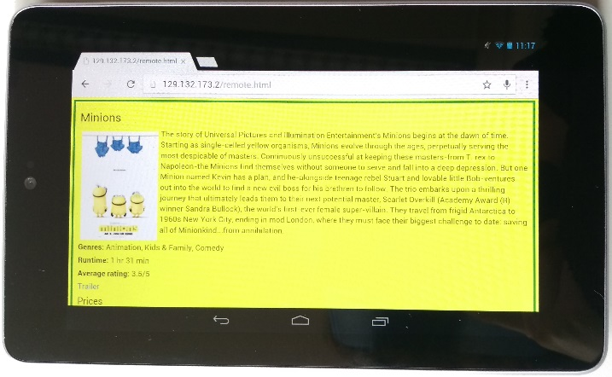
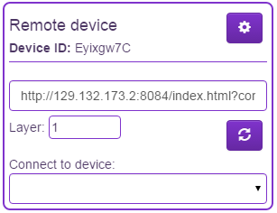
Integration of Real Devices
Motivation Related Work XDTools Architecture Sample Applications Evaluation Conclusion Future Work
Goal: It should be easy to connect real devices to XDTools
Scan a QR code to connect a real device
Device represented by a proxy in XDTools
Can be used alongside emulated devices
Most features of XDTools are also available for real devices
Real device
Proxy of real device

Slide 10
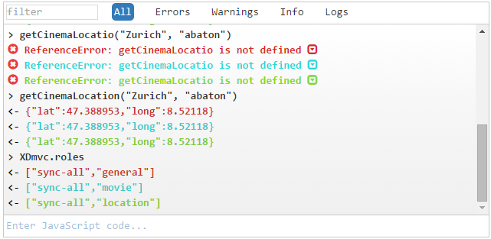
Integration with Debugging Tools (1)
Motivation Related Work XDTools Architecture Sample Applications Evaluation Conclusion Future Work
Goal: Include popular features of browser debugging tools in XDTools
Shared JavaScript console
Aggregates all console outputs
Send commands to multiple devices
Shared CSS editor: Apply CSS rules to multiple devices
Shared JavaScript console
Notes:
- Show videos!!!

Slide 11
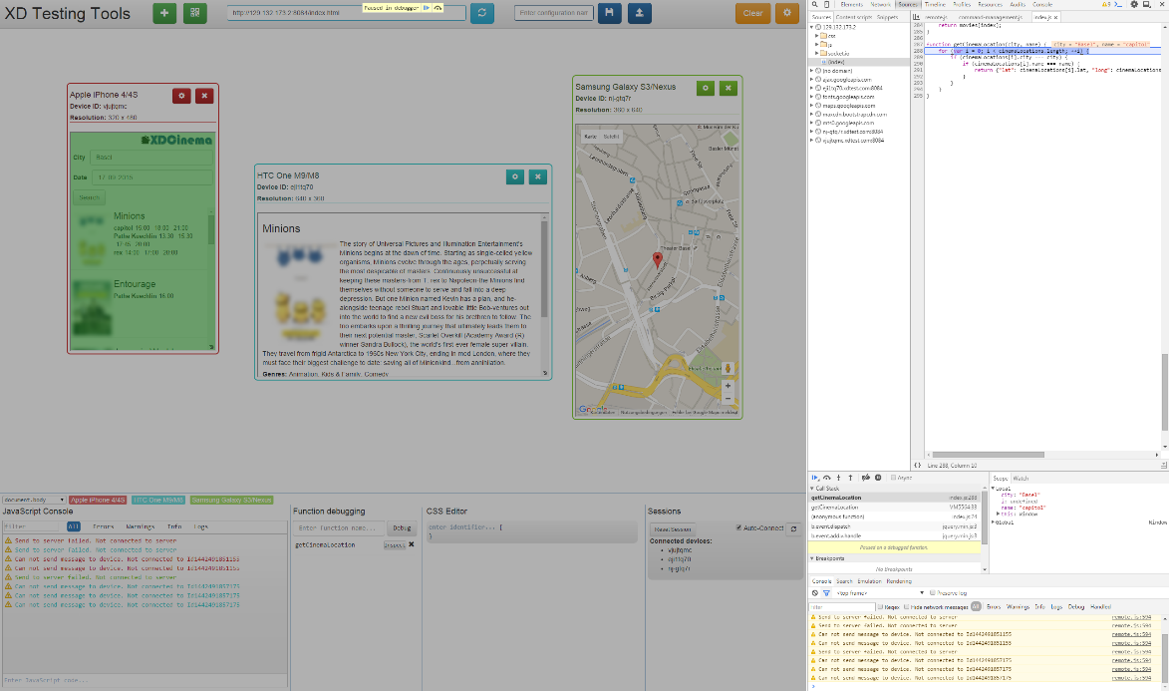
Integration with Debugging Tools (2)
Motivation Related Work XDTools Architecture Sample Applications Evaluation Conclusion Future Work
Function debugging: Set a breakpoint at the beginning of a function on multiple devices
HTML Inspection: Directly jump to the body element of an emulated device in the Chrome DevTools
Function debugging and HTML inspection only work for emulated devices
Function debugging
Notes:
- Show videos!!!

Slide 12
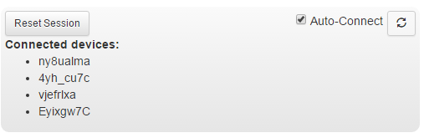
Automatic Connection Management
Motivation Related Work XDTools Architecture Sample Applications Evaluation Conclusion Future Work
Goal: It should be possible to automatically and manually connect devices
Session = set of connected devices
Auto-connect can be enabled for one session
All newly created/connected devices are automatically connected to that session
Drop-down menu to manually connect devices
A session

Slide 13
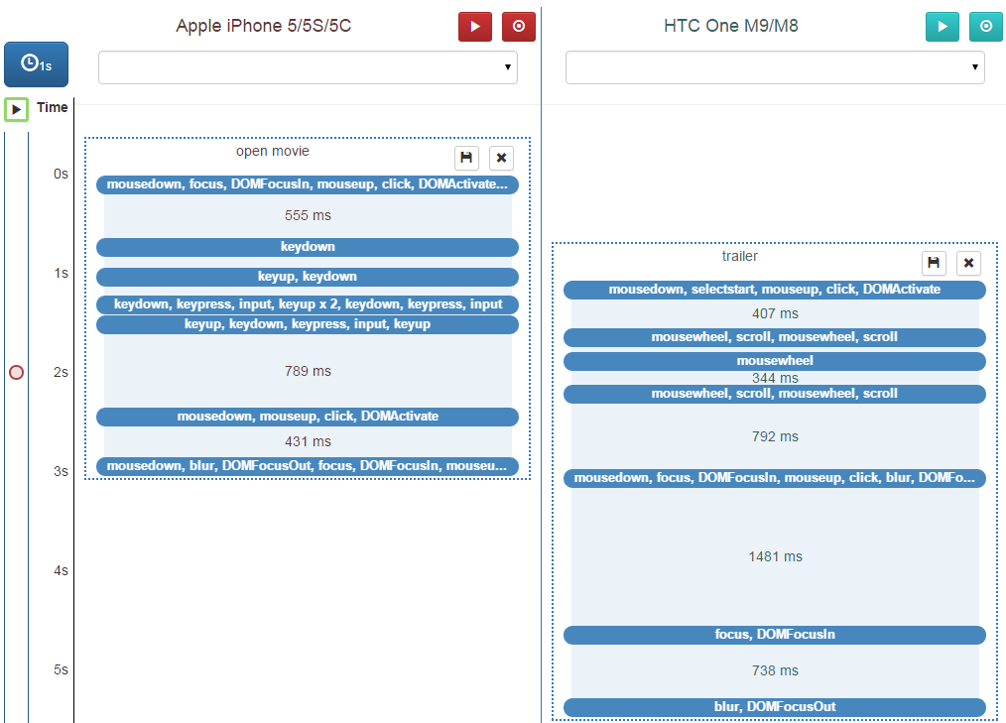
Record and Replay
Motivation Related Work XDTools Architecture Sample Applications Evaluation Conclusion Future Work
Goal: Provide a record and replay mechanism that allows accurate timing and replaying on multiple devices simultaneously
Simulate multiple users
Recorded event sequences are visualized
Move event sequences to different devices
Configure the timing using drag and drop
Set breakpoints
Visualized event sequences
Notes:
- Show video!!!

Slide 14
Architecture
Motivation Related Work XDTools Architecture Sample Applications Evaluation Conclusion Future Work
Developer Machine
DNS Server
Web application:
Socket.io
jQuery
jQuery UI
Bootstrap
jQuery.qrcode
rainbow-dns
Main application
Requests subdomain
Chrome extension
Application Server
No restrictions
Application under test
Real devices
Main application, commands, script
Server
Helper
Helper application, commands, script
Node.js with Express
Helper
Notes:
The same as in the midterm except for Chrome extension
Extension required for HTML inspection + function debugging
Explain why DNS server is used
Explain script

Slide 15
Sample Applications
Motivation Related Work XDTools Architecture Sample Applications Evaluation Conclusion Future Work
XDYouTube
XDCinema
Insights
Notes:
Explain why we developed sample applications
Gain insights about XDTools
Improvements
Also used for user study

Slide 16
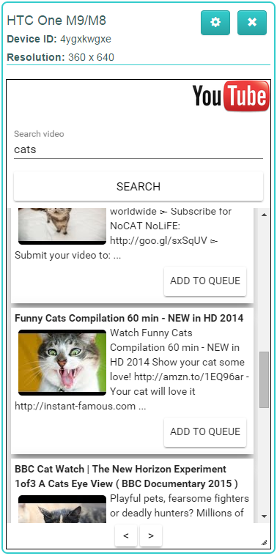
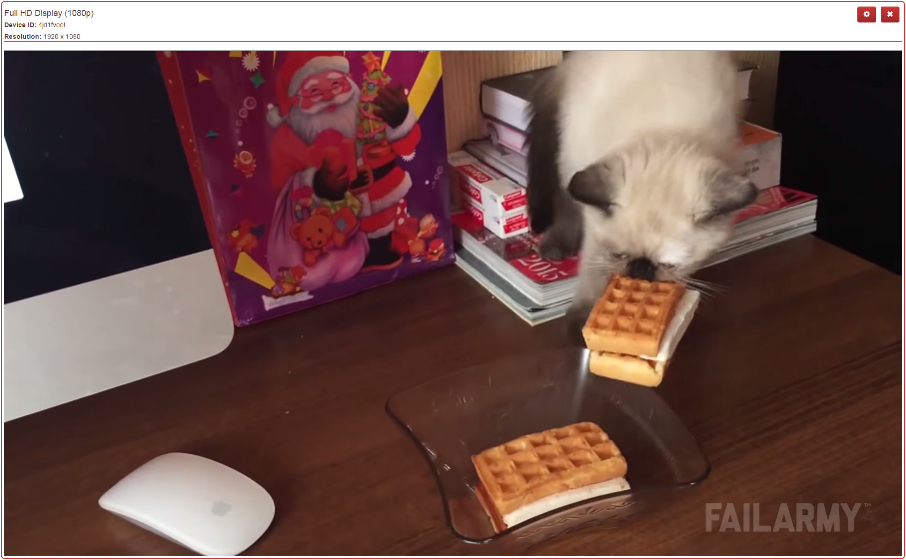
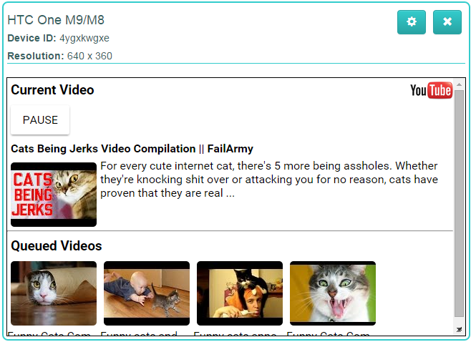
XDYouTube
Motivation Related Work XDTools Architecture Sample Applications Evaluation Conclusion Future Work
Player view
Controller view
Plays the current video
Largest device
Search and queue videos
Play/pause videos
See current video + queue

Slide 17
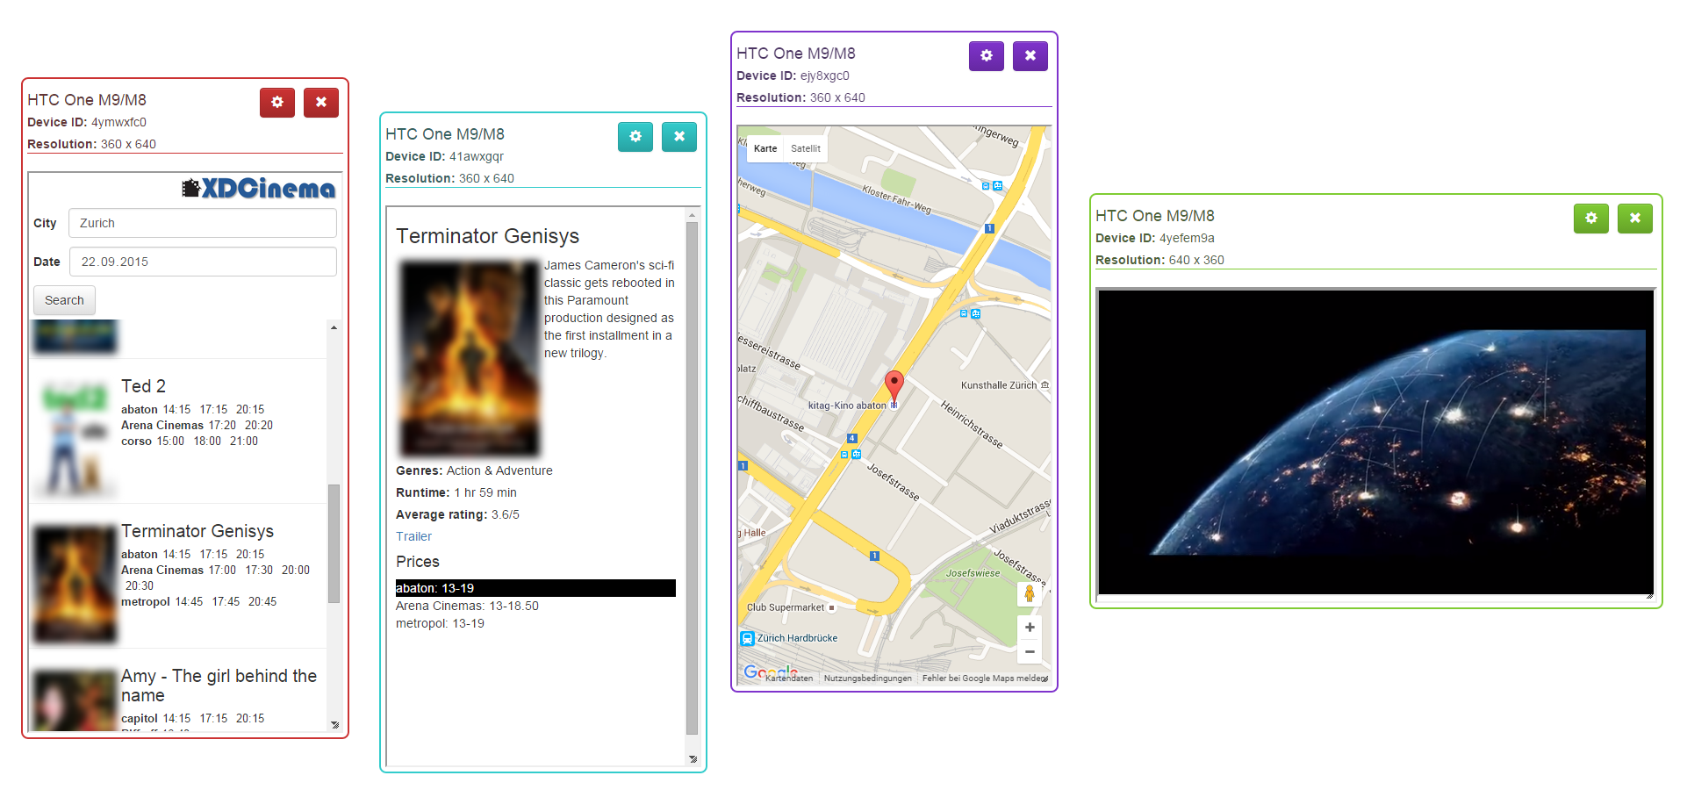
XDCinema
Motivation Related Work XDTools Architecture Sample Applications Evaluation Conclusion Future Work
Check the cinema program
Four views:
Search view: Search for movies in the cinema
Movie view: Movie description, ratings, ...
Location view: Location of a cinema
Trailer view: Plays the trailer of a movie
Trailer view
Location view
Search view
Movie view

Slide 18
Insights
Motivation Related Work XDTools Architecture Sample Applications Evaluation Conclusion Future Work
Some easy way of debugging the JavaScript of devices is required
Function debugging
Manually connecting devices is tedious
Automatic connection management
XDTools was helpful while developing the applications
Especially emulation of multiple devices
Notes:
We consider XDTools helpful, but we developed it and you certainly need more proof of that
→ user study!

Slide 19
Evaluation
Motivation Related Work XDTools Architecture Sample Applications Evaluation Conclusion Future Work
Setup
Participants
Tasks
XDYouTube implementation task
REsults

Slide 20
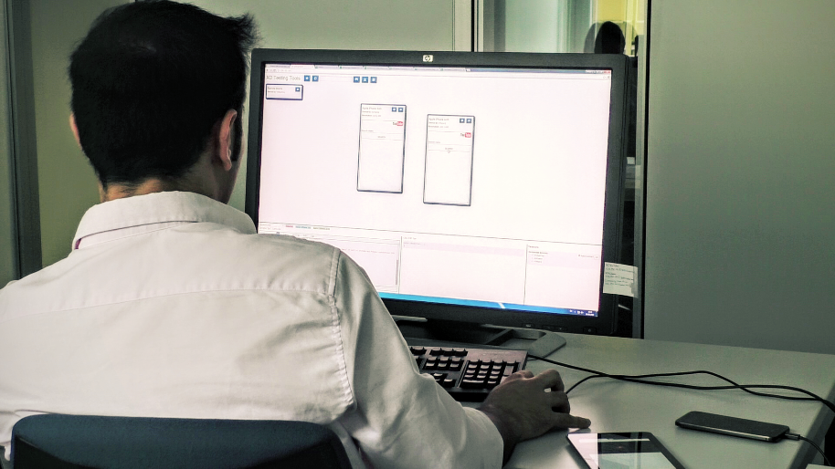
Setup
Motivation Related Work XDTools Architecture Sample Applications Evaluation Conclusion Future Work
Browser debugging tools as a baseline for comparison
Remote debugging was prepared
5 Chrome profiles were created
30-inch screen and 2 additional devices
Tablet: Asus Nexus 7
Phone: HTC One M9
Some features were disabled, e.g. record and replay
Study setup

Slide 21
Participants
Motivation Related Work XDTools Architecture Sample Applications Evaluation Conclusion Future Work
12 participants (2 female), median age 26
All members of the computer science department of ETH
Basic knowledge in client-side web technologies required
8 out of 12 participants had some cross-device development experience
Most of them used both real and emulated devices for testing
Most participants were familiar with Chrome DevTools
Experience from basic to proficient
Experience with Chrome DevTools
Notes:
- Partipants judged their experience as rather good
No-one claims to only have basic experience
HTML/CSS inspection/modification and console most popular
Device mode and JS debugging less popular

Slide 22
Tasks
Motivation Related Work XDTools Architecture Sample Applications Evaluation Conclusion Future Work
Sample applications used for the tasks
One app with XDTools, the other without
One debugging and one implementation task per application
Time limit 15 and 30 minutes
Order of the applications was counter-balanced
Questionnaire after each task and after completing all tasks
XDYouTube
Debugging task: Fix a bug related to the video queue
XDCinema
Debugging task: Wrong location was returned because of a switched variable
Implementation task: Implement a remote control for the video
Implementation task: Display and highlight prices of cinemas that show a movie

Slide 23
XDYouTube Implementation Task
Motivation Related Work XDTools Architecture Sample Applications Evaluation Conclusion Future Work
Overall, it seems that participants benefited the most from XDTools in this task
Participants found that the task was easier and more efficient to complete with XDTools
Device emulation, connection features and JavaScript console most popular for this task
Features were generally rated as very useful
Comparison XDTools – browser tools
N. of participants that used a feature and their ratings
Notes:
Figure shows median values
Big difference for all questions
In other tasks, small or no difference for some questions
Other figure shows how many people used a particular feature
And whether they agree that the feature is useful

Slide 24
Results (1)
Motivation Related Work XDTools Architecture Sample Applications Evaluation Conclusion Future Work
Participants generally preferred implementing and debugging with XDTools
Participants would use XDTools while implementing and debugging cross-device applications
Preference for implementing
Preference for debugging
Usefulness of XDTools
Notes:
Participants clearly preferred XDTools
Other figure shows if participants would use XDTools and if they think that it is generally useful

Slide 25
Results (2)
Motivation Related Work XDTools Architecture Sample Applications Evaluation Conclusion Future Work
5 tasks aborted (for 3 different participants)
Very similar task completion times
What if participants had more time to get used to XDTools?
Slightly higher number of emulated devices used with XDTools
Real devices were rarely used
No difference in task completion strategies
Average number of emulated devices
Notes:
Similar task completion times → no gain in efficiency could be observed
Higher number of emulated devices could be because adding devices is easier
Mostly speculation, further confirmation is needed

Slide 26
Conclusion
Motivation Related Work XDTools Architecture Sample Applications Evaluation Conclusion Future Work
No tools available that allow exhaustive testing of cross-device applications
Potential reason for the low availability of such applications
XDTools improves the testing and debugging process of cross-device applications
User study showed promising results and participants provided some enthusiastic feedback
“I wish I had access to the tool when I was working on a cross-device application last year.”
XDTools serves as a basis for future research in cross-device testing

Slide 27
Future Work
Motivation Related Work XDTools Architecture Sample Applications Evaluation Conclusion Future Work
Tighter integration with browser
Integrate XDTools directly into browser debugging tools
More advanced access to features
Long-Term Study
Let developers use XDTools while developing an entire application
Analyse usage
Extended record and replay
Apart from recording interactions, also record other non-deterministic data
Periodic feedback
Workarounds like the DNS server can be avoided
Dates, random numbers, server responses, interrupts, ...
First step: Github
Tighter integration with browser
Integrate XDTools directly into browser debugging tools
More advanced access to features
Long-Term Study
Let developers use XDTools while developing an entire application
Analyse usage
Extended record and replay
Apart from recording interactions, also record other non-deterministic data
Periodic feedback
Workarounds like the DNS server can be avoided
Dates, random numbers, server responses, interrupts, ...
First step: Github
Tighter integration with browser
Integrate XDTools directly into browser debugging tools
More advanced access to features
Long-Term Study
Let developers use XDTools while developing an entire application
Analyse usage
Extended record and replay
Apart from recording interactions, also record other non-deterministic data
Periodic feedback
Workarounds like the DNS server can be avoided
Dates, random numbers, server responses, interrupts, ...
First step: Github

Slide 28
Questions?
Thank you for your attention!

